Slide 1

Building a Child-Friendly Learning Platform
This presentation outlines our vision for a child-friendly learning platform. We'll discuss the design process, key features, and anticipated impact.

Slide 2
Our Team
Lucky Singh
Atharv Tayal
Dhruv goel
Jitendar
Lead Developer, responsible for overall platform architecture and functionality.
UI/UX Designer, crafting a user-friendly and engaging interface.
Content Specialist, curating engaging and age-appropriate educational content.
Report

Slide 3
Index
1
Empathize
2
Define
3
Ideate
Understanding the needs of young learners and their parents.
Identifying the core problem to be addressed.
Exploring innovative solutions and features.
4
Prototype
5
Test
Building a working prototype to test and refine.
Gathering user feedback and iterating on the design.

Slide 4
Empathize: Understanding Our Users
Persona
Empathy Map
Our target user is a 6-year-old child with a curious mind and a love for learning.
This map captures the thoughts, feelings, needs, and pain points of our user.

Slide 5

Define: The Problem Statement
To create a safe, engaging, and educational online learning environment for young children, addressing the need for interactive and age-appropriate content.

Slide 6

Ideate: User Process Flowchart
1
Login/Registration
Parents create an account and set learning goals for their children.
2
Content Exploration
Children browse through various educational modules based on their interests.
3
Interactive Learning
Children engage with games, activities, and quizzes to learn new concepts.
4
Progress Tracking
Parents monitor their child's progress and provide personalized support.

Slide 7



Fostering Social Interaction
Collaboration
1
Children work together on projects and activities.
Communication
2
Children can chat with each other and share their progress.
Engagement
3
Children feel connected and motivated to learn.

Slide 8
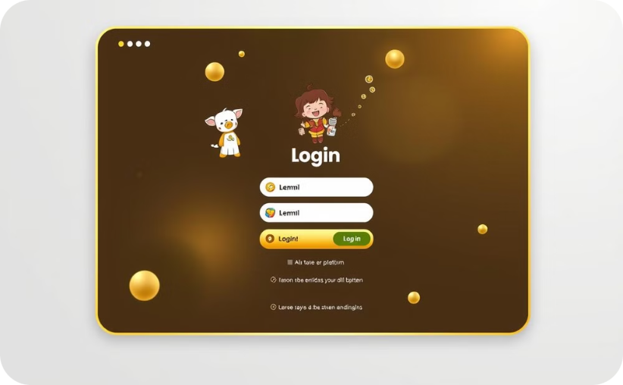
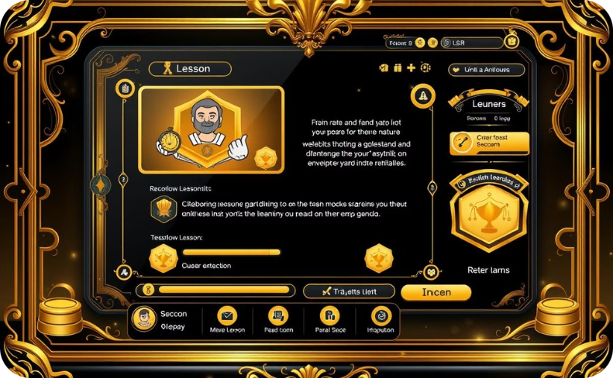
Prototype in Progress
Login Screen
Learning Module
A user-friendly and engaging login screen with colorful icons and a simple layout.
A fun and interactive learning module with engaging visuals and interactive activities.

Slide 9
Empowering Parents and Guardians
Personalized Feedback
1
Parents receive progress reports and personalized insights.
Engaging Communication
2
Parents can communicate with educators and receive support.
Safe Environment
3
The platform ensures a safe and monitored learning environment.

Slide 10
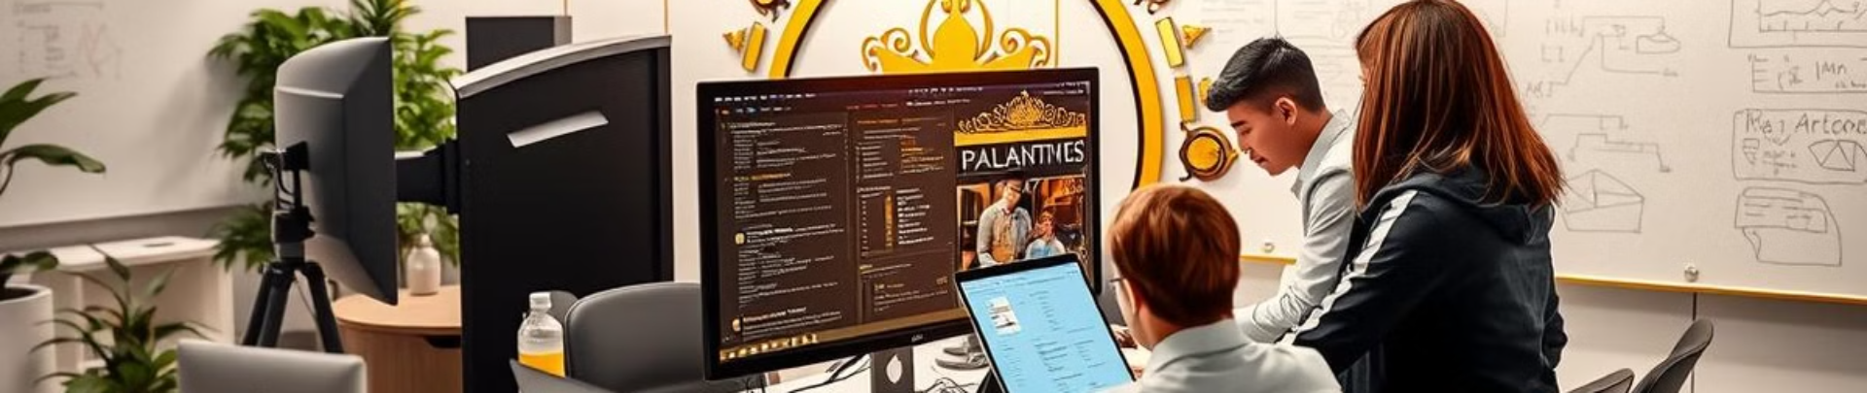
Conclusion: Future Scope and Implementation
The platform will continue to evolve with new content, features, and accessibility options. We plan to launch a beta version in the coming months, followed by a full release.

